Slide 1




IT TICKET & DASHBOARD SYSTEM
MINI JIRA

Slide 2

PROBLEM STATEMENT
IT teams struggle with task tracking → need a single page for:
Creating tickets
Moving tasks across stages
Monitoring progress visually
Boosting developer motivation

Slide 3
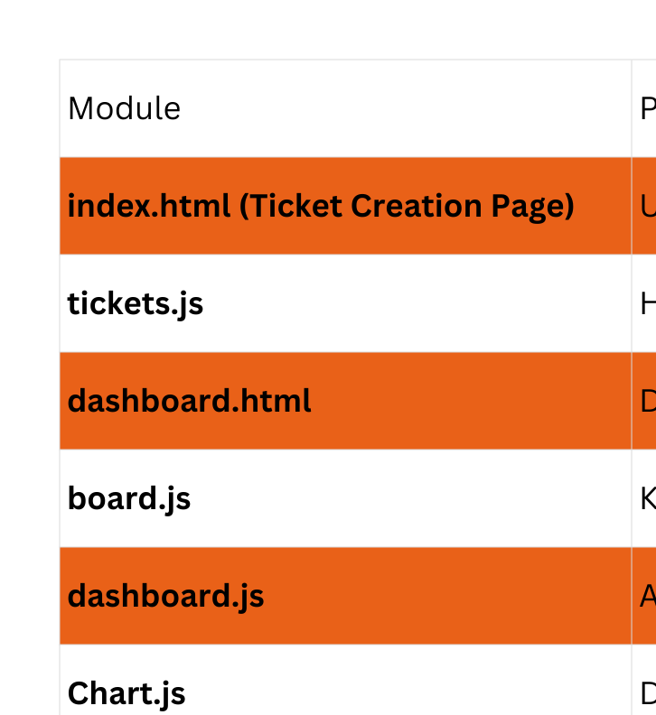

Slide 4
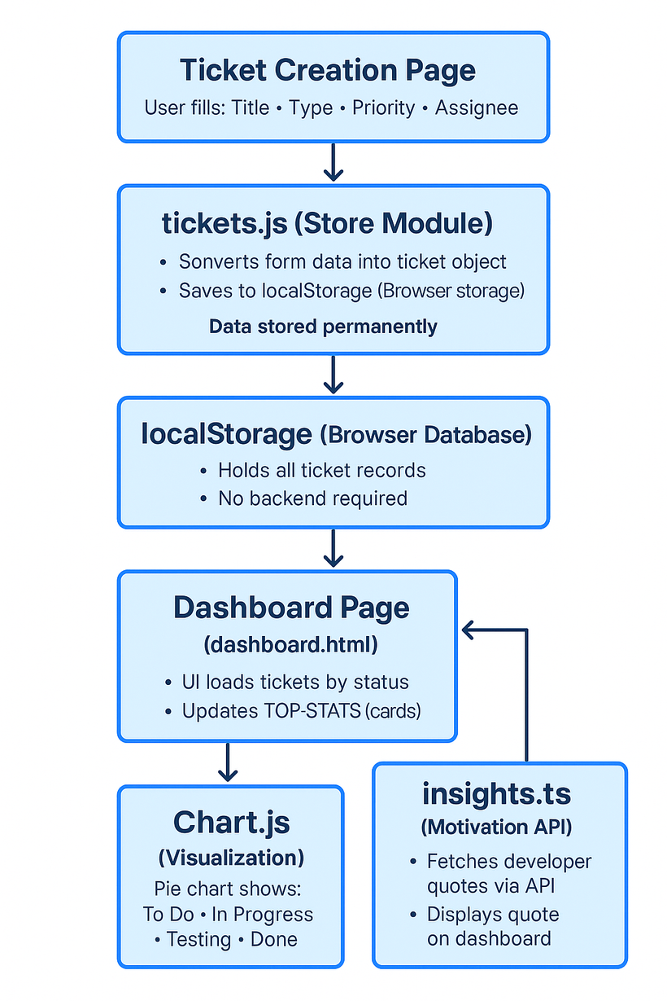
WORK FLOW

Slide 5

TECHNOLOGIES USED
HTML5
CSS3 / TailwindCSS
JavaScript (ES6)
TypeScript
LocalStorage
Fetch API
Chart.js

Slide 6

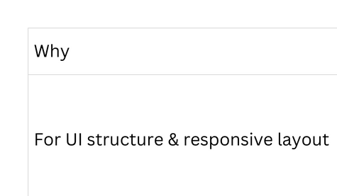

TECHNOLOGY: HTML + TAILWIND

Slide 7
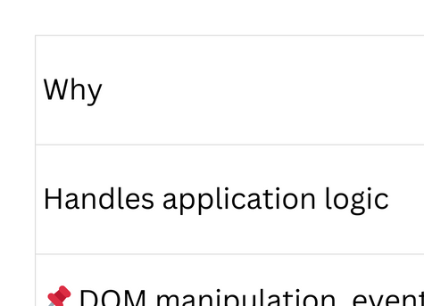



TECHNOLOGY: JAVASCRIPT (ES6)

Slide 8
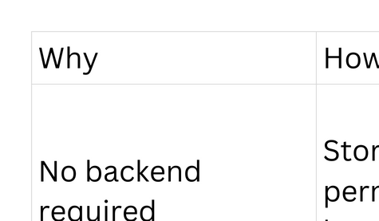


STORAGE: LOCALSTORAGE

Slide 9



TYPESCRIPT + API INTEGRATION

Slide 10
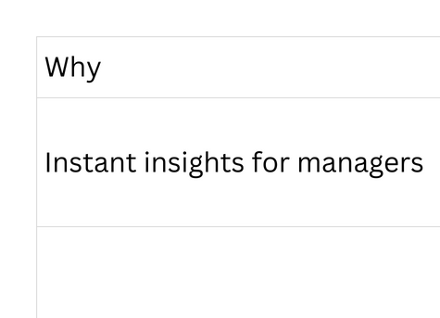
DATA VISUALIZATION

Slide 11
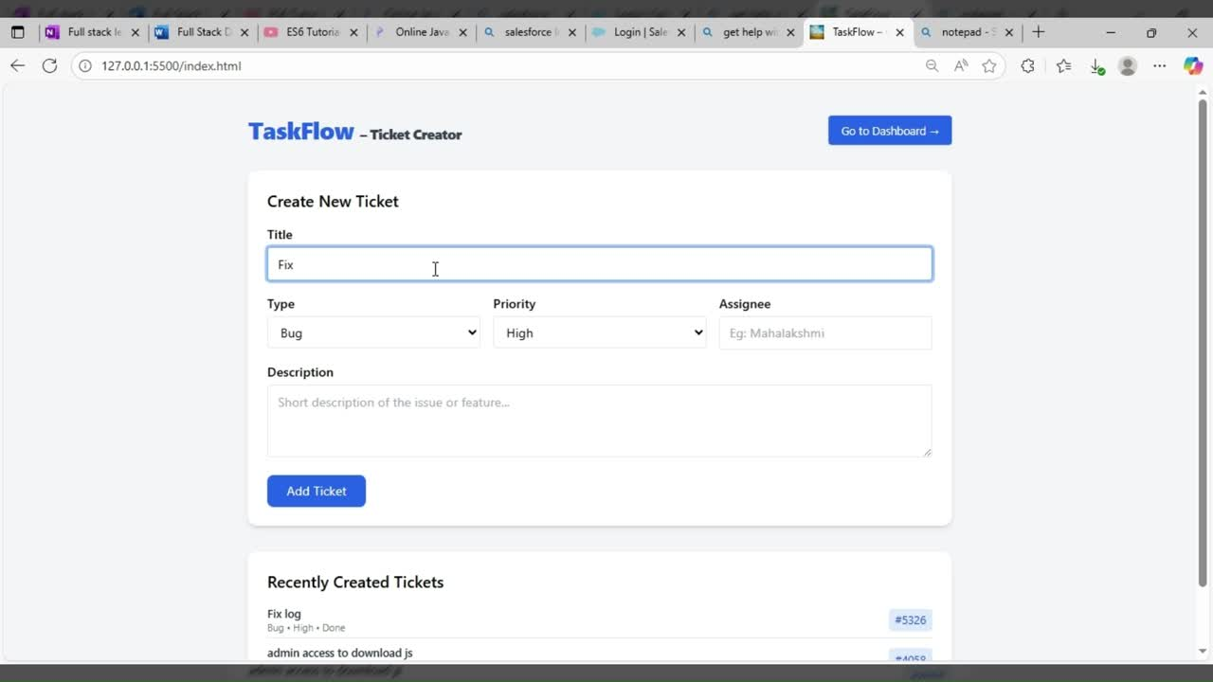

Slide 12
THANK YOU
LINK: https://mahalakshmimageswaran.github.io/Week-01-Portfolio-Website/
MAHALAKSHMI M

